Slide 1
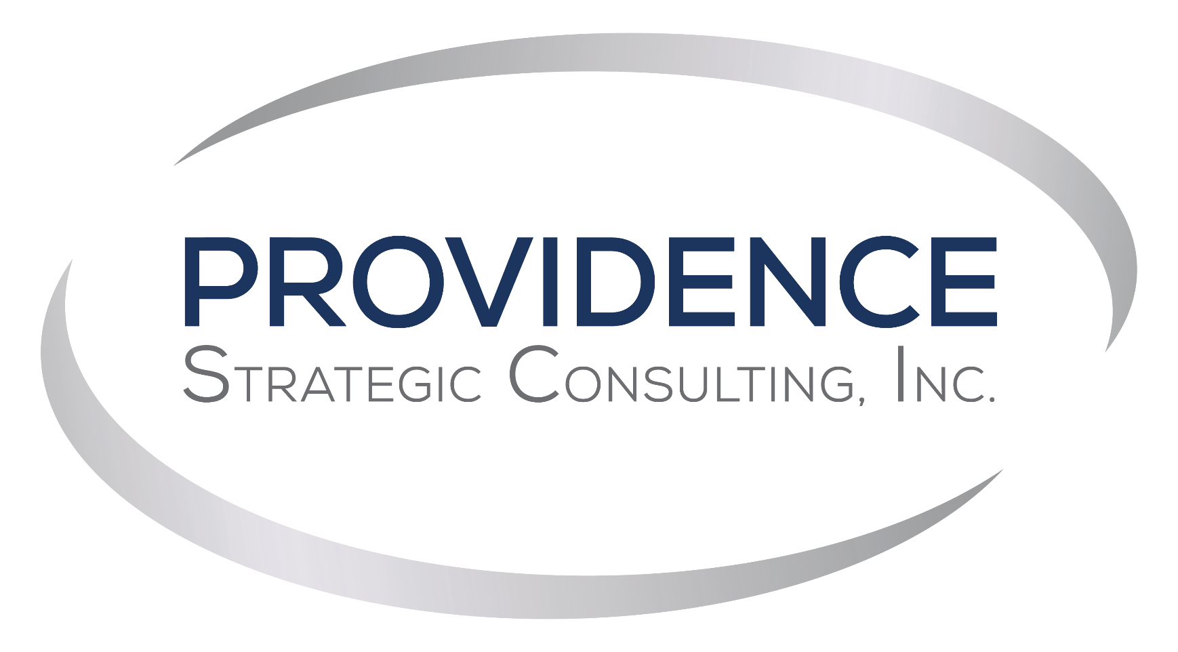
REDEFINING COMMUNICATIONS

Slide 2
Objectives & Presenter
Today, you will learn how to plan and schedule
your content for Give Big Kern and beyond!
Madison Carter
Project Manager
Madison Carter
provconsult.com

Slide 3
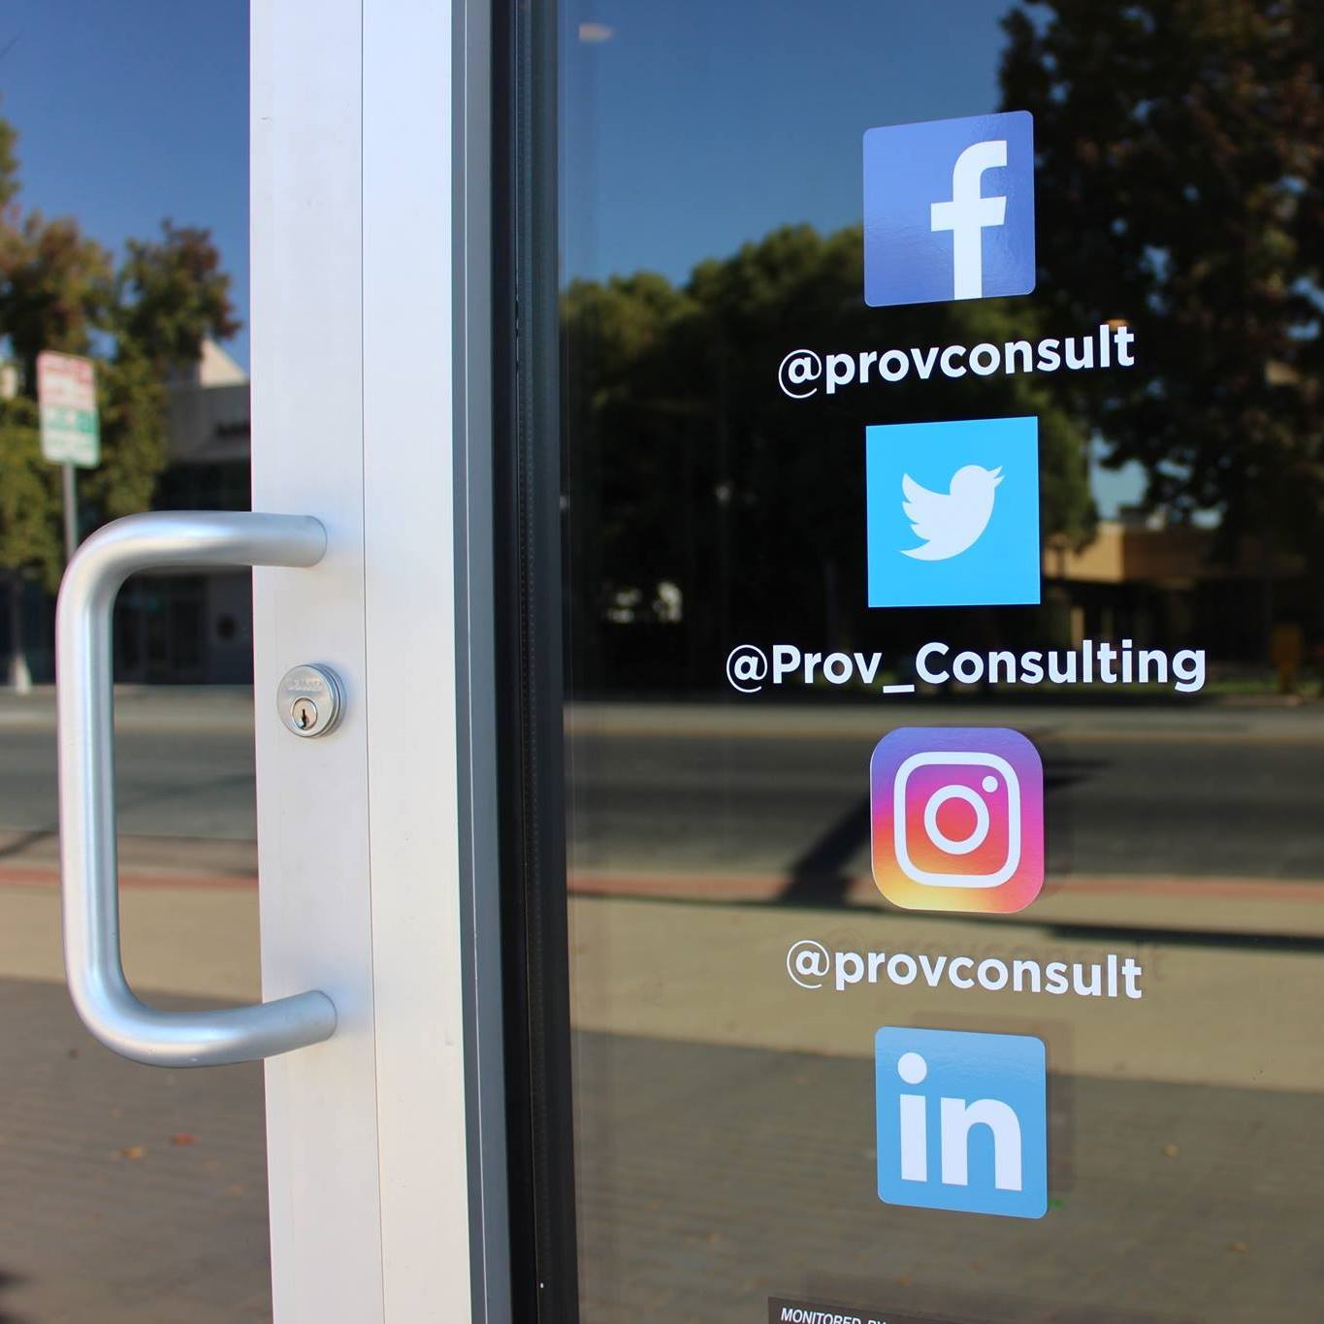
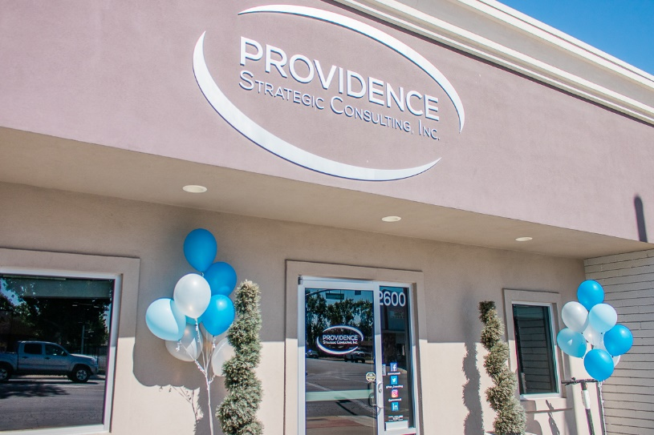
ABOUT PROVIDENCE
Strategic communications firm
Public relations, public affairs, marketing and advertising, and government services.
15 years of experience in the Central Valley
Madison Carter
provconsult.com

Slide 4
What about you?
Madison Carter
provconsult.com

Slide 5
Pop Quiz!
Madison Carter
provconsult.com

Slide 6
Recap
Facebook remains the most popular social media platform
By 2021, more than 3 billion people will be using social media (InfluencerMarketingHub, 2020).
Facebook
Instagram
Twitter
LinkedIn
Tik Tok
Madison Carter
provconsult.com

Slide 7
Review: Content Creation
Brainstorm: campaign objectives, tone
Create Goals: SMART Goals
Dos and Don’ts
- Do: Visuals
- Don’t: Excessive text
- Do: Proofread
- Don’t: Set it and forget it
Madison Carter
provconsult.com
Notes:
Get all your ideas on paper. We’re not trying to pinpoint on our winner here, we just want to create as many possible ideas as possible.
Once we’ve brainstormed we can start thinking of how our goals pertain to these ideas to narrow down our list.
Visuals: People respond the best to photos and videos
Excessive text: People aren’t on FB to read mountains of text
Proofread: Don’t want to pay for ads that have spelling or grammatical errors!
Set it and DON’T forget it: You want to stay up to date on and consider how you can improve your content.

Slide 8
Let’s talk about the importance of daily check-ins!
Madison Carter
provconsult.com

Slide 9
Types of Content
Holidays
Events
Special occasions
Thank your audience
Famous quotes
Highlight employees
Ask questions
Testimonials
Photo contest
Tell a story
Education
Promotions
Madison Carter
provconsult.com

Slide 10
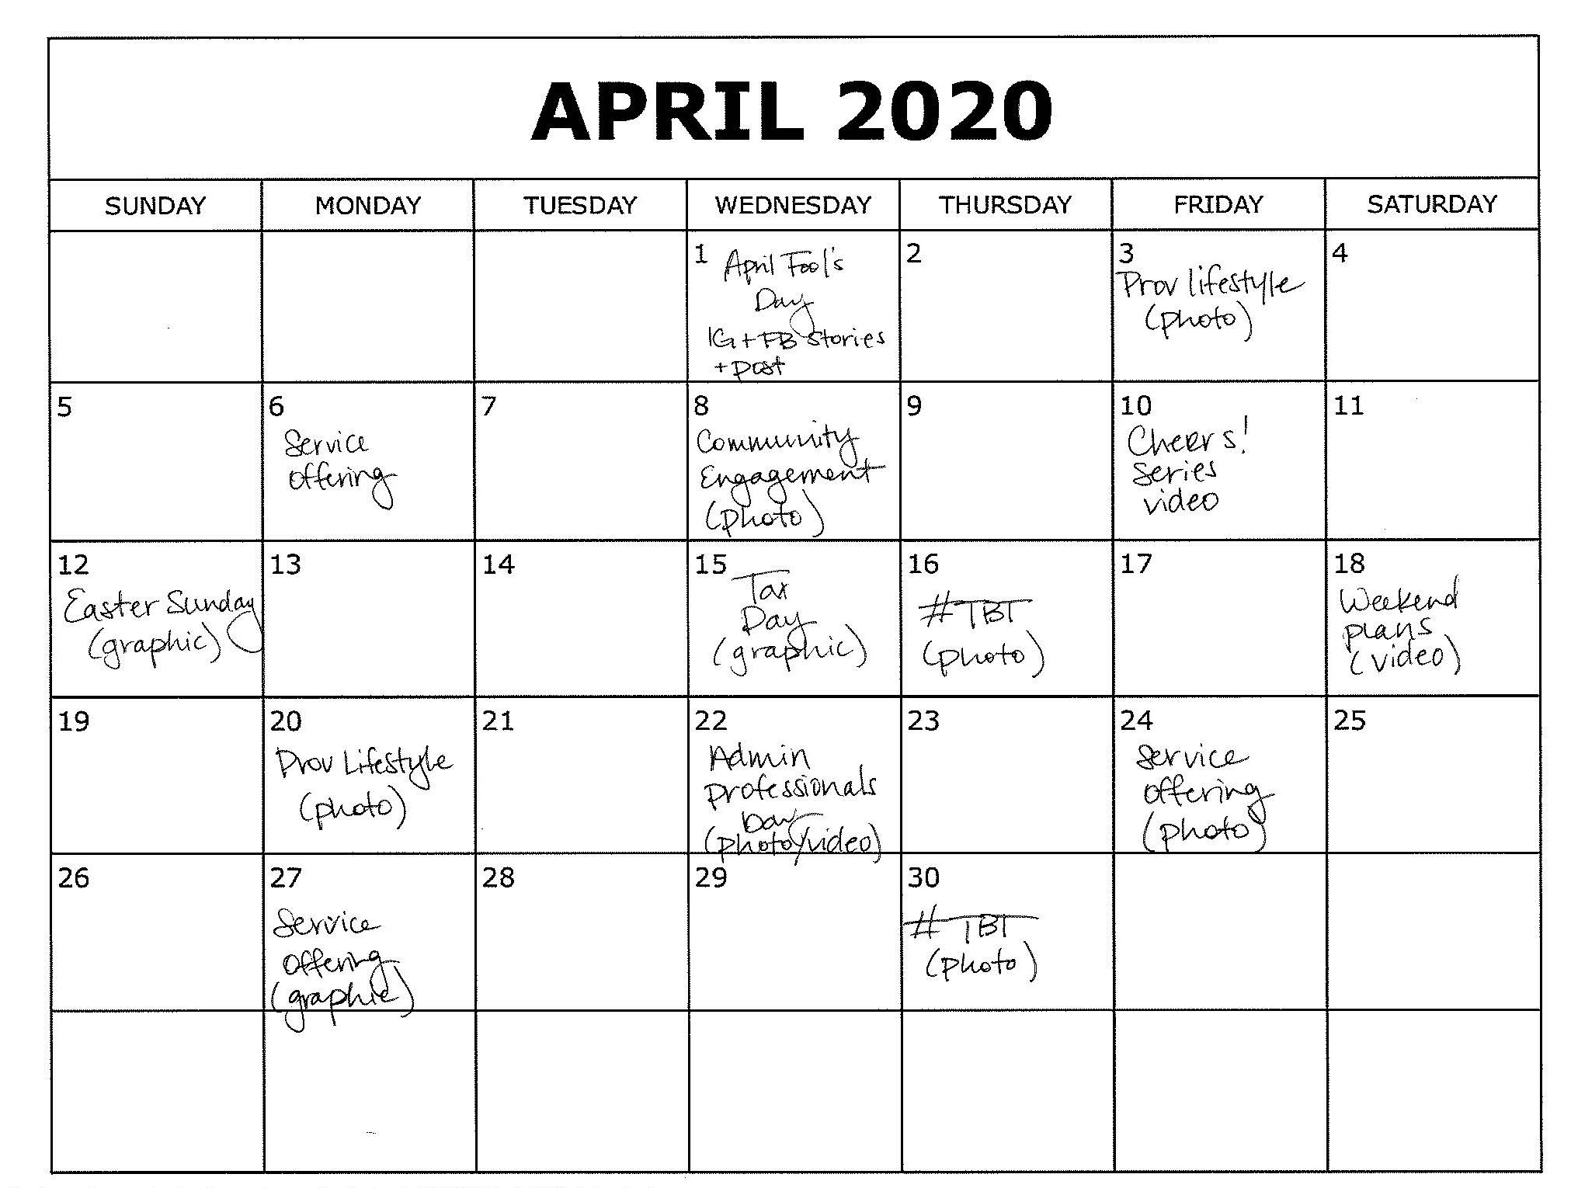
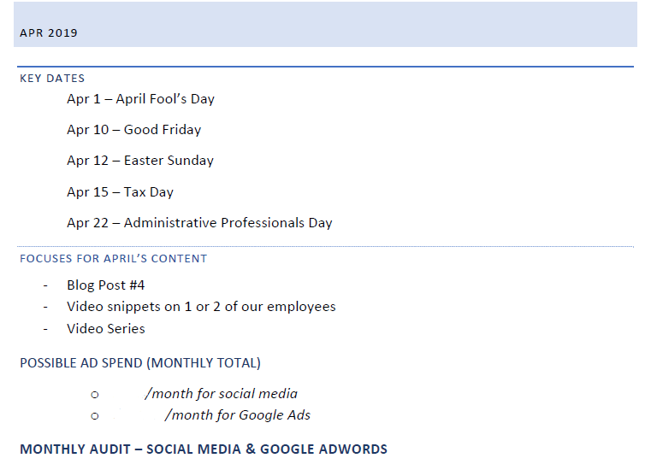

Slide 11
Activity Time!
Madison Carter
provconsult.com

Slide 12
Business Manager
Easy access
Maintain control
Add ad accounts
No cost
Go to business.facebook.com to learn more!
Madison Carter
provconsult.com
Notes:
Free
“By having all your Facebook information in one place, your business maintains control of your Facebook assets, and securely manages user access to the right people and right credit lines.” – Facebook
(Facebook) You should use Business Manager if:
- You have more than 1 person working on your Facebook and/or Instagram marketing
- You need to manage multiple Facebook or Instagram assets such as Facebook Pages, ad accounts, or app
- You use a vendor to help create, run, or manage your Pages or ads, but want your business to maintain ownership of all Pages, ad accounts, and assets
- You want control over access and permissions to your assets without attributing ownership to individuals who assist your business operations
- You want to request access to other pages, ad accounts, and apps, or share your pages, ads accounts, and apps with other agencies

Slide 13
Scheduling content
Notes:
Did you know you can schedule social media posts straight from your Facebook?
Click More > Publishing tools > Scheduled Posts > + Create

Slide 14
3rd Party Scheduling Tools
Sendible, Hootsuite, eClincher, Sprout Social, Buffer, Later, etc.

Slide 15
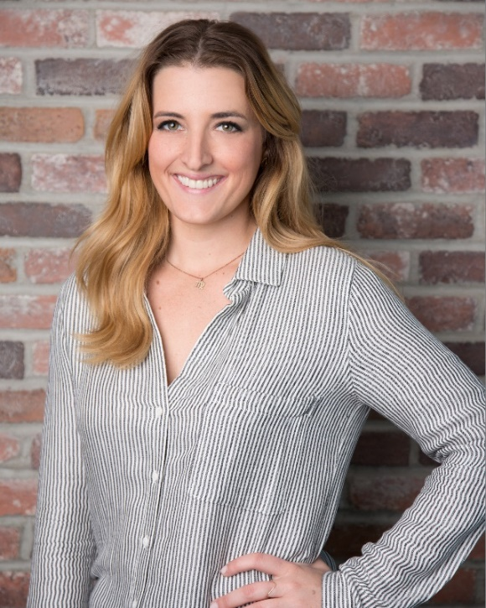
Questions?
@provconsult
Providence Strategic Consulting
@prov_consulting
@provconsult
W
www.provconsult.com
Madison Carter
Thank you for having us!

